Slide 1


C3I Summer Internship (June-July 2025)
“Analyzing job posting trends, skill gaps, and recommend reskilling programs in employment sectors”
Intern Name: Suhas Venkata Karamalaputti (PES2UG22CS590)
Mentor Name: Dr. Richa Sharma (Associate Professor)

Slide 2
AGENDA
1. Title & Problem Statement
2. Research / Industry Relevance
3. Suggestions from 1st Review – Actions Taken
4. Architecture Diagram / Proposed Approach
5. Novelty or Unique Contribution
6. Tools, Libraries, or Frameworks Used
7. Dataset Details & Preprocessing Steps
8. Hardware/Software Requirements
9. Work Progress (Demonstrate of the 50% project completion)
10. Baseline Comparison (if applicable)
11. Challenges Faced and Resolutions
12. Next Steps and Remaining Work Plan
13. References

Slide 3
Problem Statement
Analyzing job posting trends, skill gaps, and recommend reskilling programs in employment sectors

Slide 4
Abstract
The skills gap is a significant challenge for job seekers. Many individuals lack the specific skills required for available positions, leading to unemployment and underemployment, so our model aims to solve this issue by analyzes a user's resume and recommends relevant online courses to bridge their skill gaps and improve their career prospects.

Slide 5
Research/Relevance -Application in Real world
Job Posting Trend Analysis: We aggregate data from multiple job boards (Naukri, NYC Jobs, specialized sector CSVs) to identify emerging skill demands. The EDA component analyzes skill distributions and cross-dataset patterns, revealing market trends.
Skill Gap Identification: NLP-based skill extraction from resumes vs. job requirements creates precise gap analysis. We can quantifiy the missing competencies for that specific job role.
Reskilling Program Recommendations: Direct integration with Coursera dataset enables skill-to-course mapping along with semantic similarity matching which can ensure relevant learning recommendations.
Real-World Impact: Job seekers can receive personalized reskilling roadmaps. Your specialized CSVs enable targeted analysis for high-demand sectors experiencing rapid skill evolution.

Slide 6
Suggestions from 1st Review – Actions Taken
Work on the project and make some progress
Find some more papers relevant to the problem statement

Slide 7
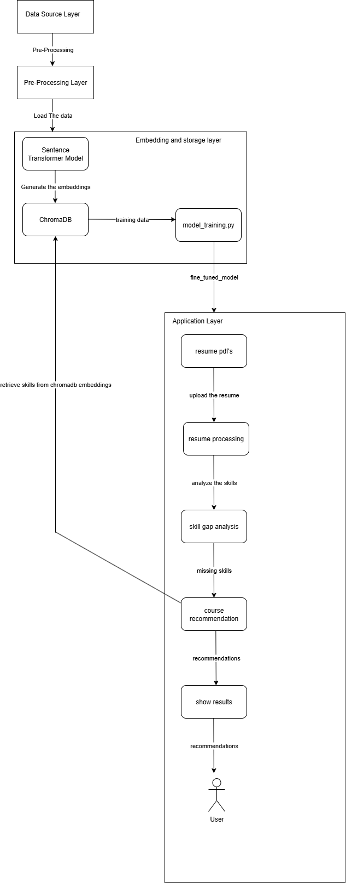
Architecture Diagram

Slide 8
Novelty or Unique Contribution
Across the papers/journals I came, it was noticed, traditional approaches like tf-idf and word2vec due to which the model is not able to capture the context, like approaches like tf-idf only focus on frequency and word2vec can’t understand anything outside it’s dictionary.
We are planning to push the data into vector database (ChromaDB) and use sentence transformer model(all-MiniLM-L6-v2) and use ollama to extract the skills from the resume, based on which the fine-tuned model can recommend skills if there is any skill gap.

Slide 9
Tools, Libraries, or Frameworks Used
Python – Main programming language
pandas – Data manipulation and analysis
numpy – Numerical computations
scikit-learn – Machine learning utilities
sentence-transformers – Semantic text embeddings (NLP)
torch (PyTorch) – Deep learning/model training
chromadb – Vector database for semantic search
spacy – Natural language processing
Ollama- For Skill extraction
tkinter – Graphical user interface (GUI)
tqdm – Progress bars for data processing
draw.io – (Optional) System architecture diagrams

Slide 10
Dataset Details & Preprocessing Steps
Job Datasets
https://www.kaggle.com/datasets/haseebkn/nyc-fresh-jobs-postings
https://www.kaggle.com/datasets/PromptCloudHQ/jobs-on-naukricom
https://www.kaggle.com/datasets/riteshmn/naukri-jan-2024-jobs-data?select=Data+Science+_+Analytics.csvw
Courses Dataset
https://www.kaggle.com/datasets/ankushbisht005/udemy-courses-data-2023
https://www.kaggle.com/datasets/azraimohamad/coursera-course-data?select=coursera_course_dataset_v3.csv

Slide 11
Dataset Details & Preprocessing Steps
3. Resume Dataset
https://www.kaggle.com/datasets/snehaanbhawal/resume-dataset
Preprocessing Steps
All CSV datasets are loaded with robust encoding handling (UTF-8, latin1, etc.).
Column names are standardized to lowercase and underscores for consistency.
Duplicate rows are removed to ensure data integrity.
Rows with more than 50% missing values are dropped.
Remaining missing values are filled with appropriate defaults (e.g., 'Unknown' for categorical, median for numerics).
Skill columns are split, lowercased, deduplicated, and standardized.
Cleaned datasets are saved as new CSV files in the preprocessed/ directory for modeling and analysis.

Slide 12
Hardware/Software Requirements
PNY GeForce RTX 4090 24GB VERTO Triple Fan DLSS 3 Graphics Card- Used for training the model.
Operating System: Windows 10/11, macOS, or Linux

Slide 13
Work Progress
Literature Survey- Done
Curating Datasets from kaggle- Done
EDA(Exploratory Data Analysis)- Done
Pre-Processing and Model Training- Done
Model Testing- Done

Slide 14
Challenges Faced and Resolutions
Integration of Ollama with the model.
Vague/Poor recommendations by the model

Slide 15
Next Steps and Remaining Work Plan
Integrate Ollama with the fined model for enchanced skill extraction
Include a resume score based on the resume uploaded by the user
Enhance the frontend by using streamlit.

Slide 16
References
https://doi.org/10.1108/JWAM-08-2024-0111
https://www.researchgate.net/publication/387087506_Survey_on_Resume_Parsing_Models_for_JOBCONNECT_Enhancing_Recruitment_Efficiency_using_Natural_language_processing_and_Machine_Learning
https://arxiv.org/abs/2410.12052v1

